Slide 1


STOCK PRICE PREDICTION
LONG SHORT-TERM MEMORY NETWORK

Slide 2
By
Seshapu Geetha (N180228)
under the guidance of
Mr. Jagadeesh Dara
Assistant Professor, Department of CSE

Slide 3


CONTENT
Abstraction
Objectives
Problem Statement
Introduction
Stock Market
Importance of Stock Market
Long Short Term Memory Network
Working Process of LSTM
Design and methodologies
Result
Conclusion
Future Enhancements
References

Slide 4

ABSTRACT
The main aim of the project is to predict the stock price closing value for a particular company by using machine learning Techniques which is used to build prediction models that can forecast the prices of stock with good accuracy. Prediction model have been proposed to incorporate all the major factors affecting the price of stocks one of the famous technique is Long short-term memory (LSTM) for training and predicting the stock price. To build the stock price prediction model, we will using Real Time company Dataset which consists last 23 years data and we are using Jupyter notebook as a software for Making the prediction. Display result by using Streamlit web app.

Slide 5

OBJECTIVES
Aim of the Project
Build the stock price prediction model which can predict the stock price for future based on the given dataset
Scope of the Project
prediction of stock price using Machine Learning will br useful for new investors to invest in stock market based on the various factors

Slide 6


PROBLEM STATEMENT
The aim of the project is to examine a number of different forecasting techniques to predict future stock returns based on past returns to construct a portfolio of multiple stocks in order to diversify the risk. We do this by applying supervised learning methods for stock price forecasting by interpreting the seemingly chaotic market data.

Slide 7

INTRODUCTION
Stock market prediction is a major exertion in the field of finance and establishing businesses.
Stock market is totally uncertain as the prices of stocks keep fluctuating on a daily basis because of numerous factors that influence like physical factors vs. psychological factors, rational and irrational behavior etc.
The solution to predict the stock price is Machine learning. Machine learning algorithms have been used to devise new techniques to build prediction models that can forecast the prices of stock and tell about the market trend with good accuracy.

Slide 8

STOCK MARKET
A stock market is a public market where you can buy and sell shares for publicly listed companies. The stocks, also known as equities, represent ownership in the company. The stock exchange is the mediator that allows the buying and selling of shares.

Slide 9
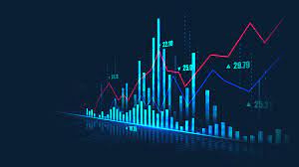
IMPORTANCE OF STOCK MARKET
Stock markets help companies to raise capital.
It helps generate personal wealth.
Stock markets serve as an indicator of the state of the economy.
It is a widely used source for people to invest money in companies with high growth potential.

Slide 10
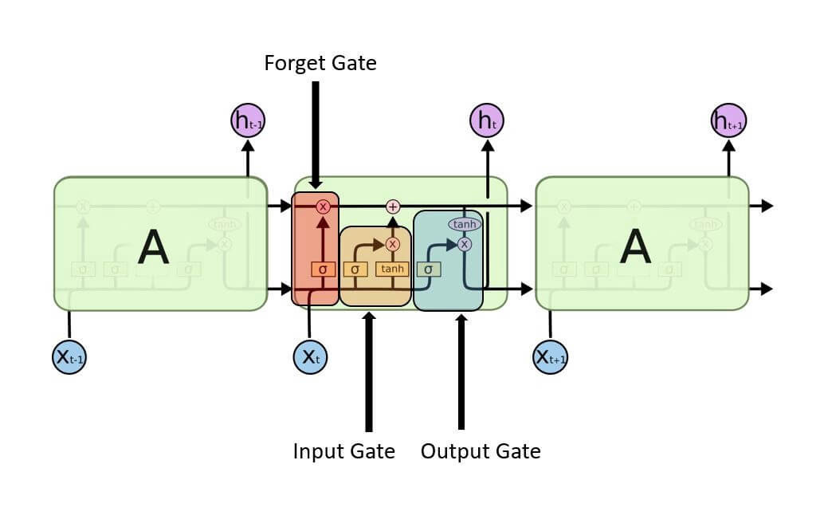
LONG SHORT TERM MEMORY NETWORK
LTSMs are a type of Recurrent Neural Network for learning long-term dependencies. It is commonly used for processing and predicting time-series data. LSTMs have a chain-like structure.

Slide 11
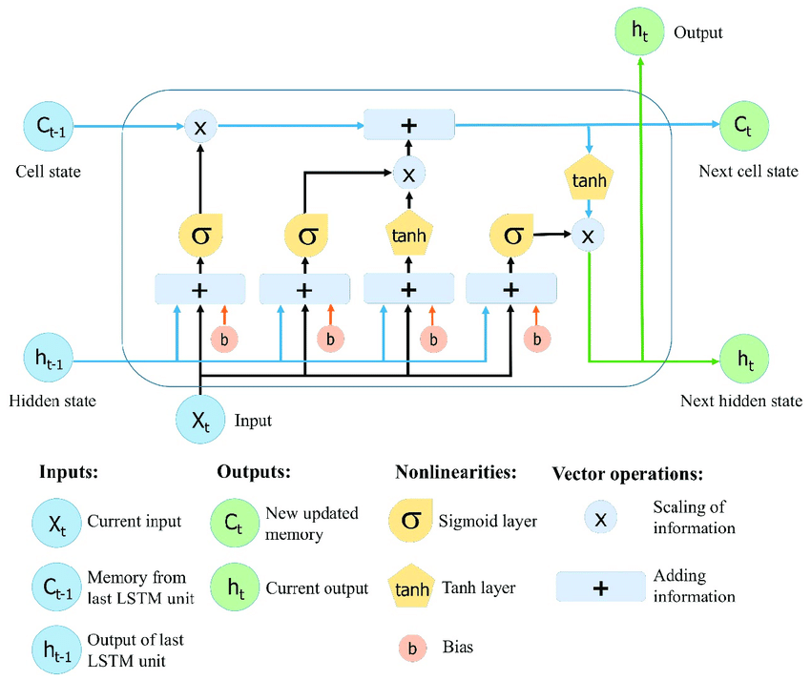
WORKING PROCESS OF LSTM

Slide 12
LSTMS WORK IN A THREE-STEP PROCESS
The first step in LSTM is to decide which information to be omitted from the cell in that particular time step. It is decided with the help of a sigmoid function. It looks at the previous state (ht-1) and the current input xt and computes the function.
There are two functions in the second layer. The first is the sigmoid function, and the second is the tanh function. The sigmoid function decides which values to let through (0 or 1). The tanh function gives the weightage to the values passed, deciding their level of importance from -1 to 1.
The third step is to decide what will be the final output. First, you need to run a sigmoid layer which determines what parts of the cell state make it to the output. Then, you must put the cell state through the tanh function to push the values between -1 and 1 and multiply it by the output of the sigmoid gate.

Slide 13

Load Dataset of specified company and Pre-processing the Dataset
Splitting the dataset for Training and Testing
DESIGN AND METHODOLOGIES
Appling the LSTM Technique for the Model
Evaluating the prediction Accuracy ang Getting the output

Slide 14
LOAD DATASET OF SPECIFIED COMPANY AND PRE-PROCESSING THE DATASET
We reading the data from yahoo which provides financial news, data and commentary including stock quotes, press releases, financial reports, and original content. It also offers some online tools for personal finance management.
We processed and sorted the data based on date.
We have divided the dataset into two files one for Training and Testing.

Slide 15

SPLITTING THE DATASET FOR TRAINING AND TESTINGT
We have divided the dataset into 2 parts one for Training and one for Testing.
We have taken Real Time Apple Dataset for the Project
The data set consists of Different attributes like Closing Price, Opening price, Volume, Date, High and Low

Slide 16

APPLYING THE LSTM TECHNIQUE FOR THE MODEL
Long short-term memory is an artificial recurrent neural network architecture used in the field of deep learning. We are using this Technique for Training the model.
LSTM networks are well-suited to classifying, processing and making predictions based on time series data, since there can be lags of unknown duration between important events in a time series.

Slide 17
EVALUATING THE PREDICTION ACCURACY AND GETTING THE OUT PUT
By using LSTM for our model we achieved an efficiency of approx. 90% of stock price closing prediction for the dataset.

Slide 18
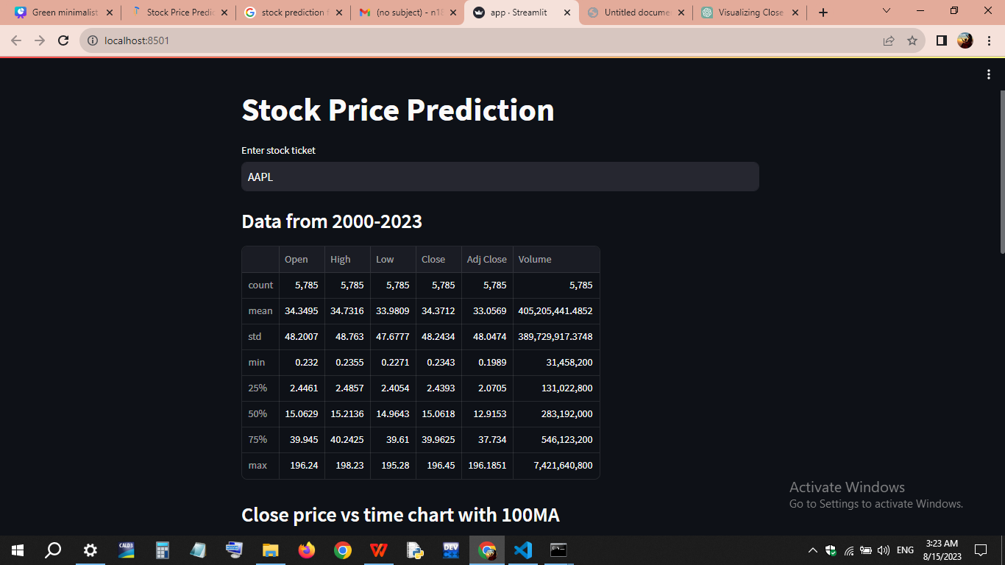
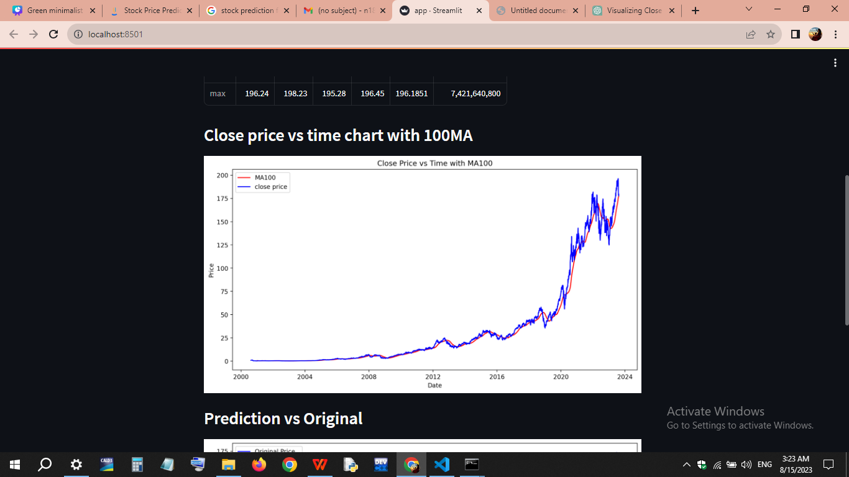
RESULT

Slide 19
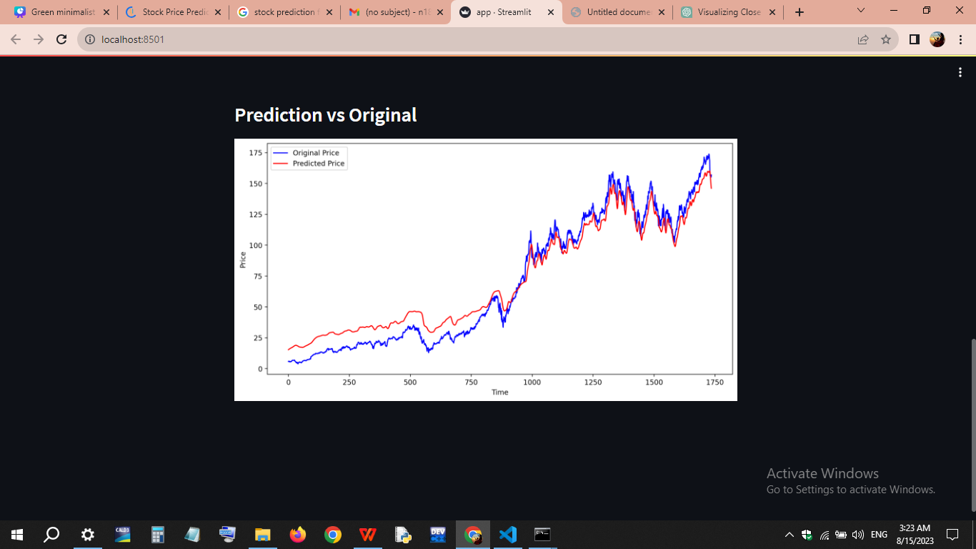
CONTINUE...

Slide 20
FUTURE ENHANCEMENTS
Ensemble methods that combine multiple LSTM models or integrate other model types for improved accuracy.
Continuous learning mechanisms to enable adaptation to evolving market conditions over time.
Efforts towards uncertainty estimation techniques to provide prediction confidence intervals.
Real-time predictions through improved speed of LSTM training and inference.

Slide 21
CONCLUSION
Stock investing has attracted the interest of many investors around the world. However, making a decision is a difficult task as many things are involved. By investing successfully, investors are eager to predict the future of the stock market.
In this project we used LSTM technique for Training the model and we have taken Apple Dataset and we trained our model.
We split the data into 70% for training and 30% for Testing.
We Predicted the Stock price closing for the Dataset.
We have achieved 90% of stock price prediction for the dataset.

Slide 22
REFERENCES
Sen, J "Stock Price Prediction Using Machine Learning and Deep Learning Frameworks" Proceedings of the 6th International Conference on Business Analytics and Intelligence, Bangalore, India, December 20-22 (2018)
Jeevan B,Naresh E "Share Price Prediction using Machine Learning Technique", IEEE Third International Conference on Circuits, Control, Communication and Computing, 2018
Adebiyi, A., Adewumi, O., and Ayo, C. K. Ayo: "Stock Price Prediction Using the ARIMA Model" In: Proc. of the Int. Conf. on Computer Modelling and Simulation, Cambridge, UK, pp. 105-111 (2018)

Slide 23


